Slide 1
Volatile Organic Compound (VOC) Sensor
Princess Hernandez
CENG317 – Hardware Production
November 27, 2018

Slide 2




Introduction TO GAS SENSORS
Gas sensors detect volatile compounds
Volatile Organic Compounds are carbon based chemicals
VOC – natural and/or man-made
Air: indoors and outdoors – vehicle exhaust, cigarette, fossil fuel
Humans: odour in urine, armpit sweat, exhaled breath
Inhalation (breathing)
Breathing vehicle exhaust, fuel emissions, releases from products and processes that contain VOCs, and cigarette and secondhand smoke
Skin contact
Touching products that contain and release VOCs

Slide 3


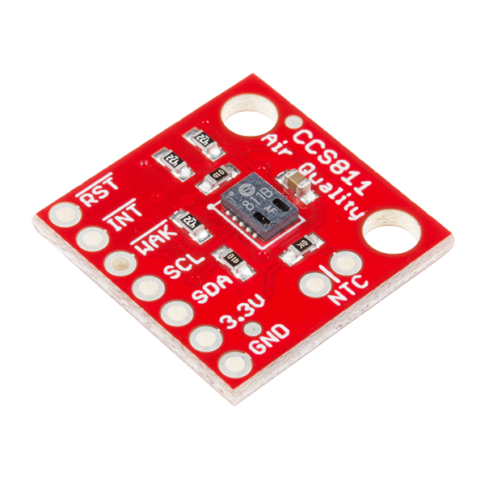
VOC Sensor
Detects hazardous compounds by photoionization
Ionize compounds in the air into +/- ions
Measures:
eCO₂ (400 – 8192 ppm)
TVOC (0 – 1187 ppb)

Slide 4
budget
Description | Source | Part # | $USD Price | $CAD Price | $USD Total | $CAD Total
SparkFun Air Quality Breakout - CCS811 | Sparkfun | SEN-14193 | $19.95
Break Away Headers - Straight | Sparkfun | PRT-00116 | $1.50
Import Fee |  |  |  | $14.92
Shipping and Handling |  |  | $21.99
 |  |  |  |  |  | $73.50
7 Pin Receptacle Socket | Creatron Inc. | CONHD-000007 |  | $0.45
Tax and Customs |  |  |  | $0.02
Shipping and Hanlding |  |  |  | N/A
 |  |  |  |  |  | $0.47
Raspberry Pi 3 Starter Kit | Amazon | N/A | N/A | N/A | N/A | N/A
Humber Parts kit | Bookstore | N/A | N/A | N/A | N/A | N/A
PCB | Prototype Lab | N/A | N/A | N/A | N/A | N/A
Grand Total (using CAD$1=USD$0.77) |  |  |  |  | $88.13

Slide 5
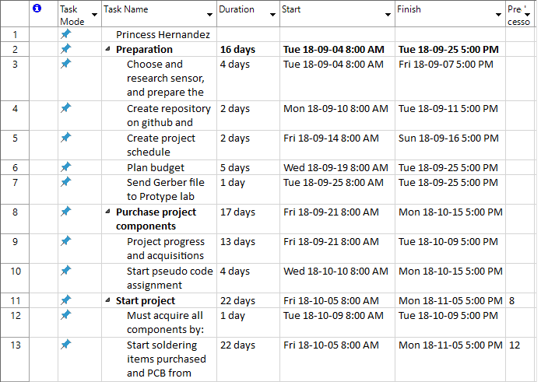
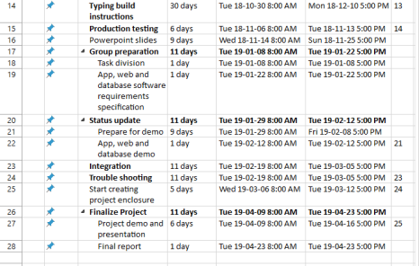
SCHEDULE

Slide 6
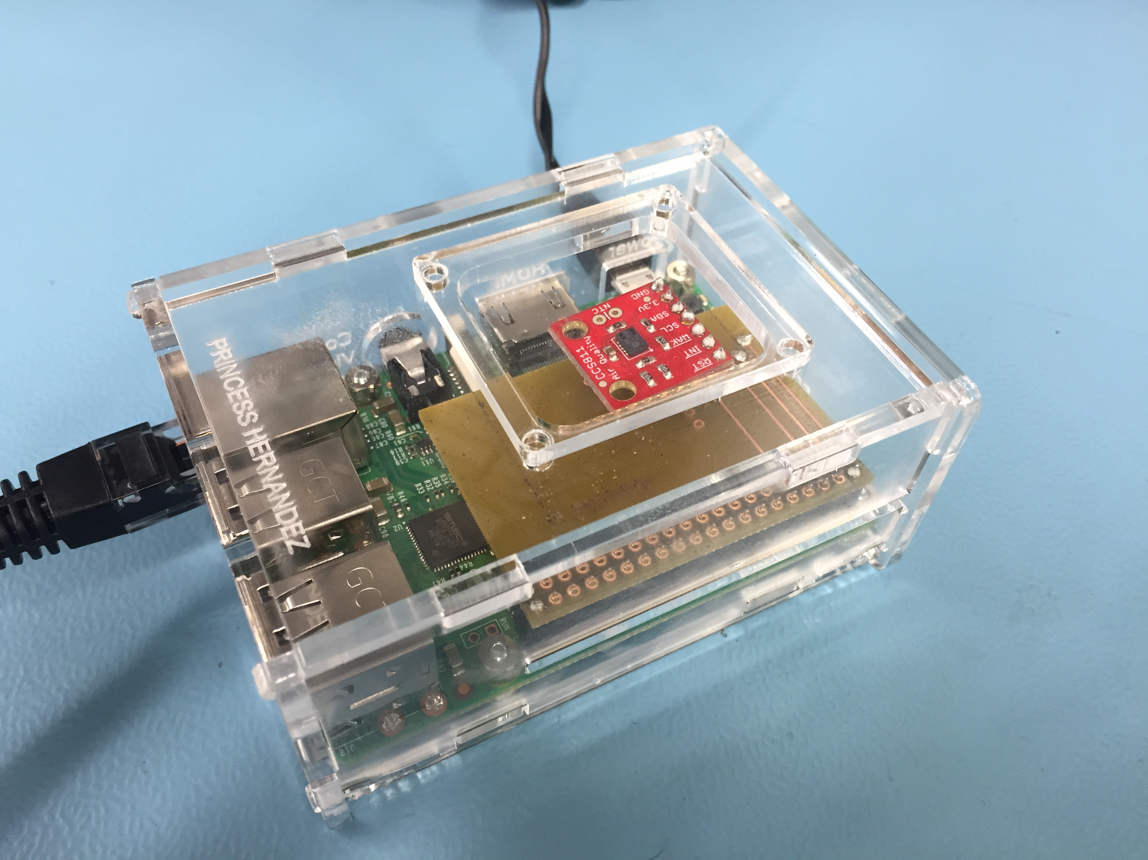
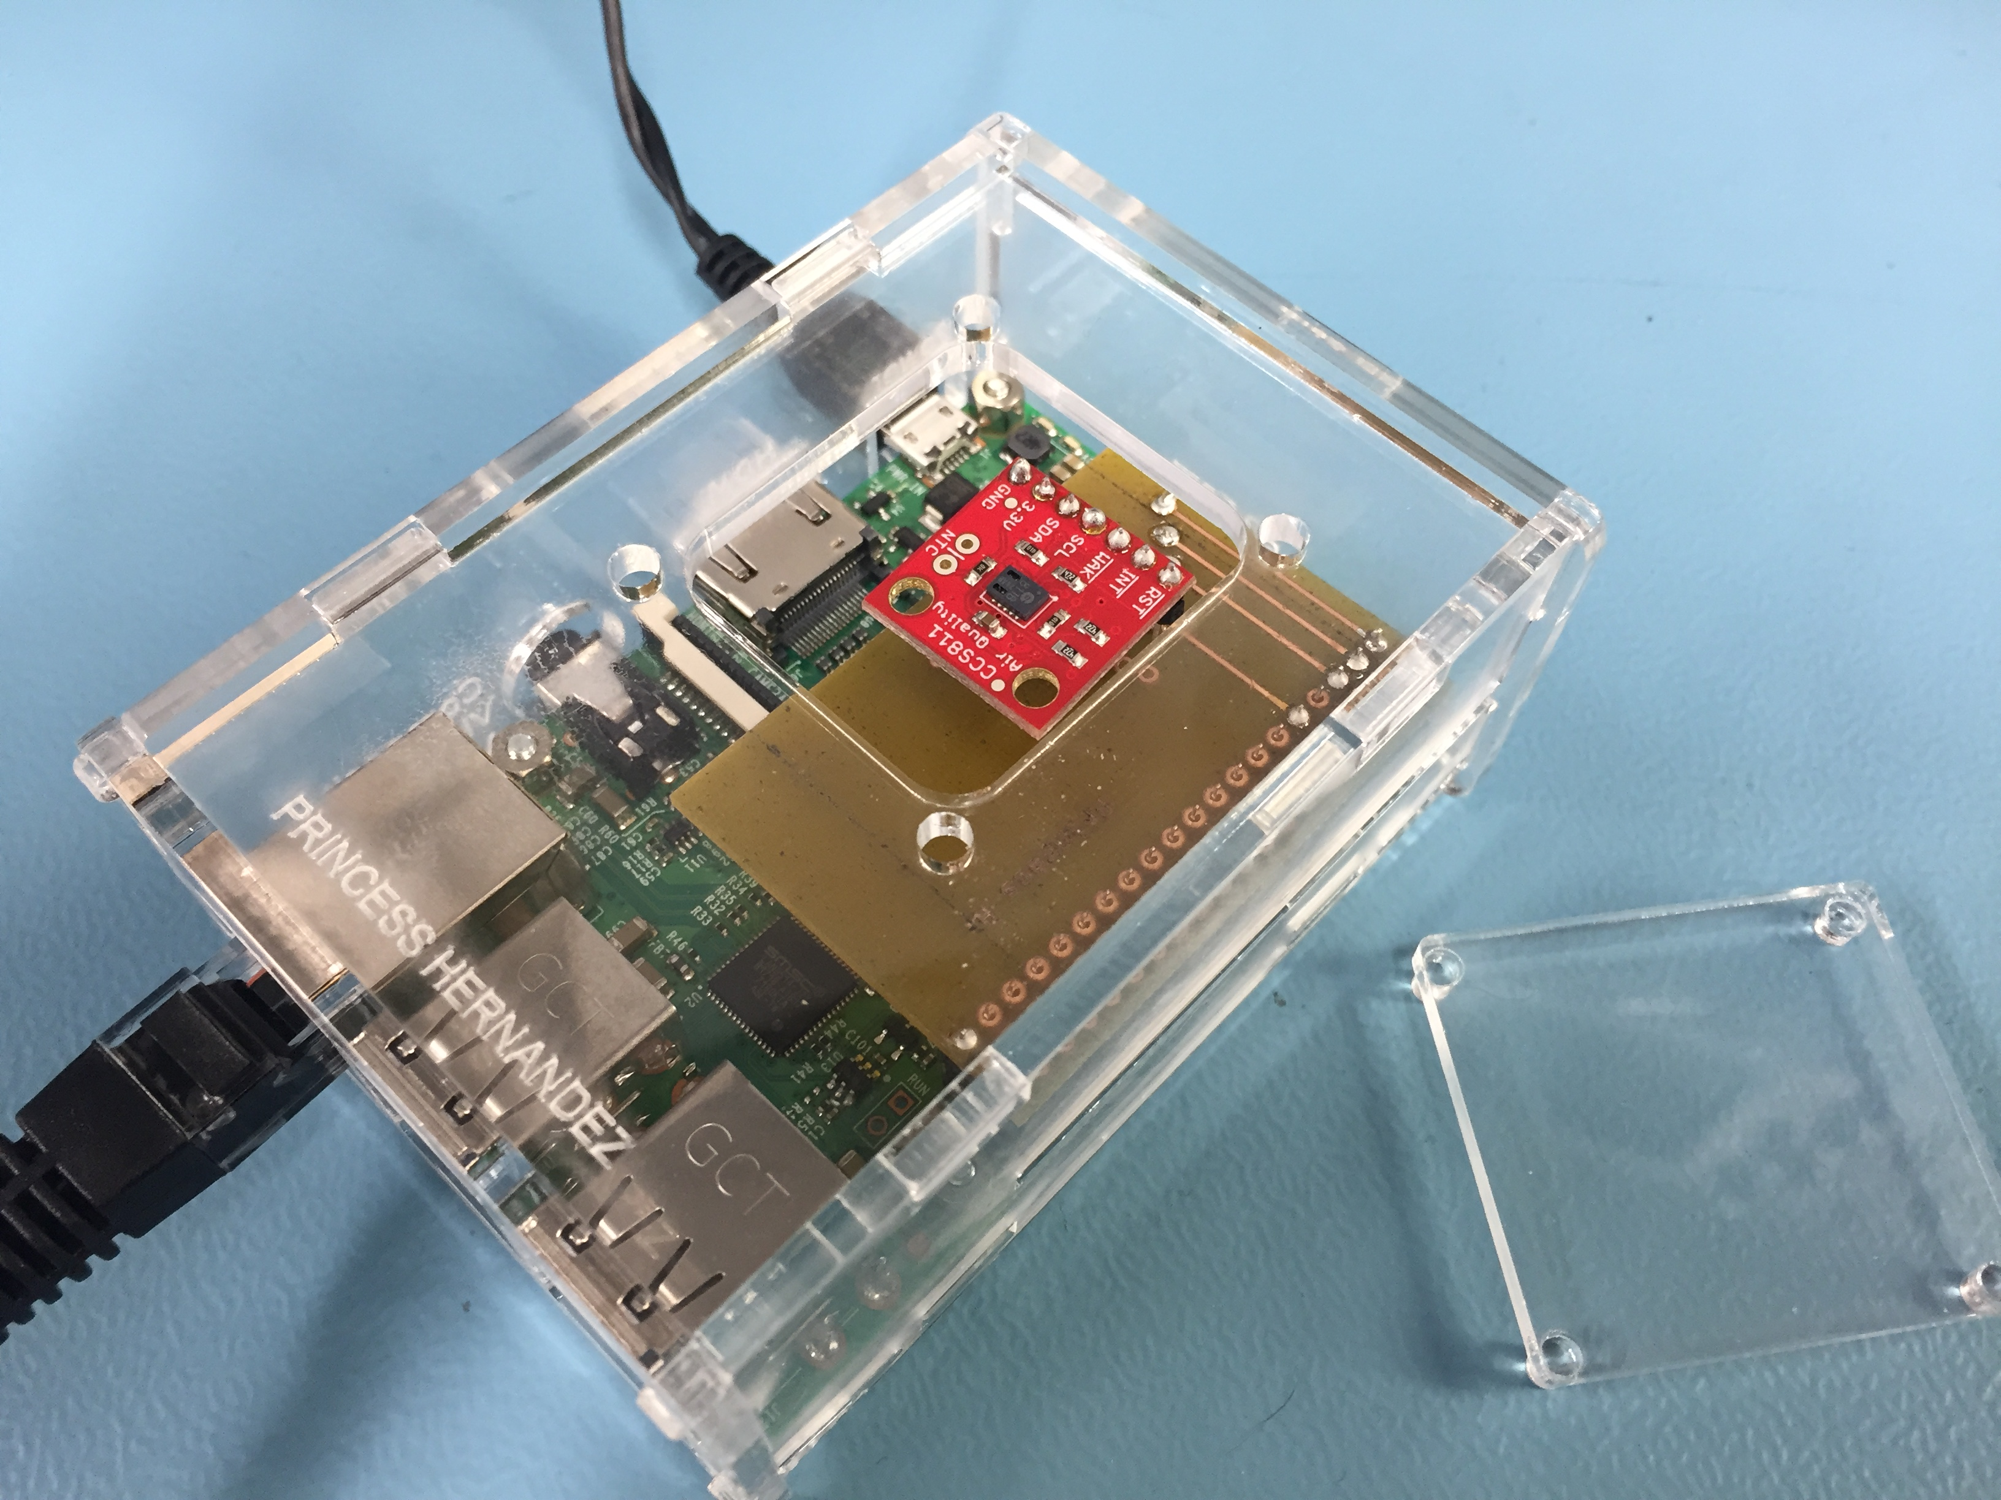
Enclosure

Slide 7
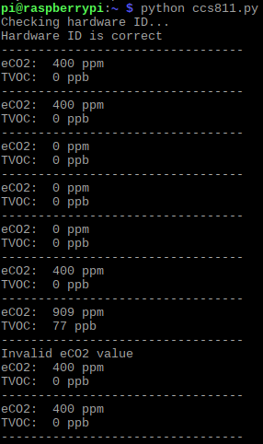
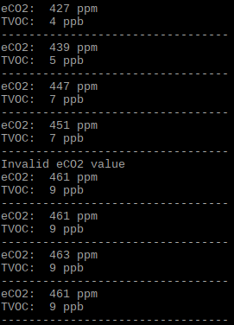
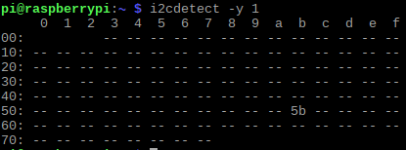
Readings

Slide 8




Course knowledge
CorelDraw
Soldering
Raspberry Pi
Github
Notes:
Soldering
Coreldraw – learned how to design a case for the project
Github – learned how to contribute to projects
Raspberry Pi – learned to up and configure the raspi for an i2c device

Slide 9
Github blog
https://princesshernandez.github.io/VOC_Sensor/

